Slide 1
Monthly Focus
Career/Program Area Focus:
T&I, Carpentry, Masonry, Electrical, Welding, Plumbing, HVAC, Construction, and Manufacturing
Soft Skill Focus:
Work Ethics

Slide 2
Trade & Industrial (T&I)
What is it?
prepares people for careers in a variety of trades, including carpentry, masonry, electrical and construction management; automotive technology; heating, ventilation and air conditioning systems; computer-aided drafting and manufacturing; and cosmetology.
What types of jobs can you get?
Construction Manager, Rotary Drill Operator, Boilermaker, Pile-Driver Operator, Plumber, Pipefitter, Electrician, Elevator Installer/Repairer, Crain Operator, Wind Turbine Technician, Brick Mason, Carpenter, HVAC Technician, and Welder
What is the median salary?
$49,400

Slide 3
Trade and Industrial Salary Snapshot
Job | Starting Salary
Project Manager | $60,000
Brick Mason | $51,740
Electrician | $47,784
Pipefitter | $54,884
Welder | $39,446
HVAC Technician | $46,420
Sheet Metal Fabricator | $48,836

Slide 4
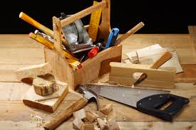
Carpentry
What is it?
is a skilled trade and a craft in which the primary work performed is the cutting, shaping and installation of building materials during the construction of buildings, ships, timber bridges, concrete formwork
What types of jobs can you get?
Construction and Building Inspectors, Construction Laborers and Helpers, Drywall and Ceiling Tile Installers, and Tapers, Flooring Installers and Tile and Marble Setters, General Maintenance and Repair Workers, Insulation Workers, Roofers, and Solar Photovoltaic Installers
What is the median salary?
$52,000

Slide 5
Masonry
What is it?
a built-up construction or combination of building units or materials of clay, shale, concrete, glass, gypsum, stone or other approved units bonded together with or without mortar or grout or other accepted methods of joining
What types of jobs can you get?
Brickmason, Blocklayer, Bricklayer, and Stonemason
Build walkways, fences, walls, patios, decks, bridges, pillars, etc.
What is the median salary?
$53,672

Slide 6
Electrician
What is it?
is a tradesman specializing in electrical wiring of buildings, transmission lines, stationary machines, and related equipment.
Electricians may be employed in the installation of new electrical components or the maintenance and repair of existing electrical infrastructure
What types of jobs can you get?
Aircraft and Avionics Equipment Mechanics and Technicians, Drafters, Electrical and Electronics Engineering Technicians, Electrical and Electronics Engineers, Electrical and Electronics Installers and Repairers, Elevator Installers and Repairers, Heating, Air Conditioning, and Refrigeration Mechanics and Installers, Line Installers and Repairers, Power Plant Operators, Distributors, and Dispatchers, and Solar Photovoltaic Installers
What is the median salary?
$47,784

Slide 7
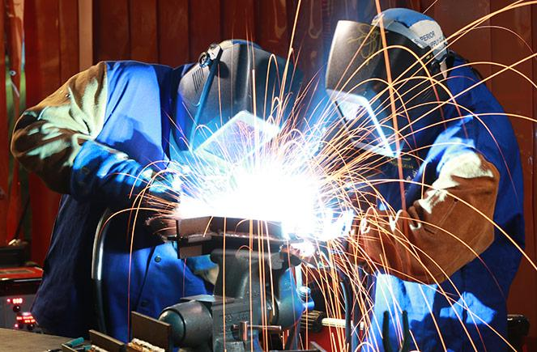
Welding
What is it?
is a skilled trade and a craft in which the primary work performed is the cutting, shaping and installation of building materials during the construction of buildings, ships, timber bridges, concrete formwork
What types of jobs can you get?
Boilermakers, Pipefitters, Ironworkers, Sheet Metal Workers, Structural and Pressure Vessel Welder, Fabrication/ Manufacturing/Production Welder, Auto Body Welder, and Aviation Welder
What is the median salary?
$39,446

Slide 8
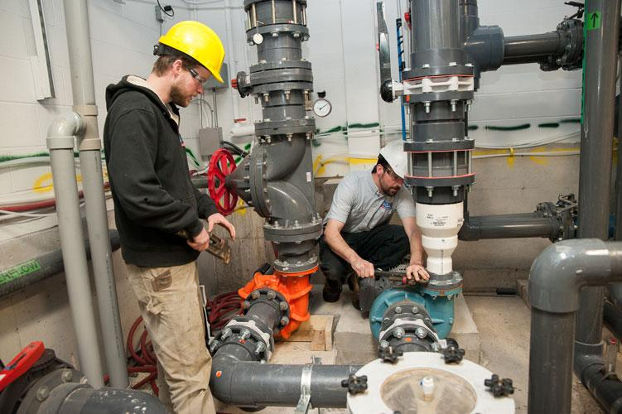
Plumbing
What is it?
the system of pipes, tanks, fittings, and other apparatus required for the water supply, heating, and sanitation in a building.
tradesperson who specializes in installing and maintaining systems used for potable water, sewage and drainage in plumbing systems
What types of jobs can you get?
Residential/Commercial Plumber, Water Treatment Facility, Service/Repair Plumber
What is the median salary?
$56,090

Slide 9
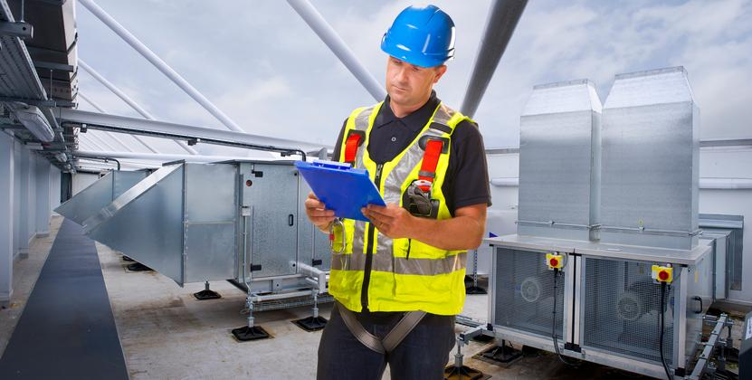
HVAC
What is it?
Heating, ventilation, and air conditioning is the technology of indoor and vehicular environmental comfort.
Supplying heating and air-conditioning to buildings and cars
What types of jobs can you get?
Residential air conditioning and heating, Commercial air conditioning and heating, and Industrial and commercial refrigeration
Service technician, Installer/Start-up Technician, Systems Designer/Engineer, and Service Manager
What is the median salary?
$56,190

Slide 10
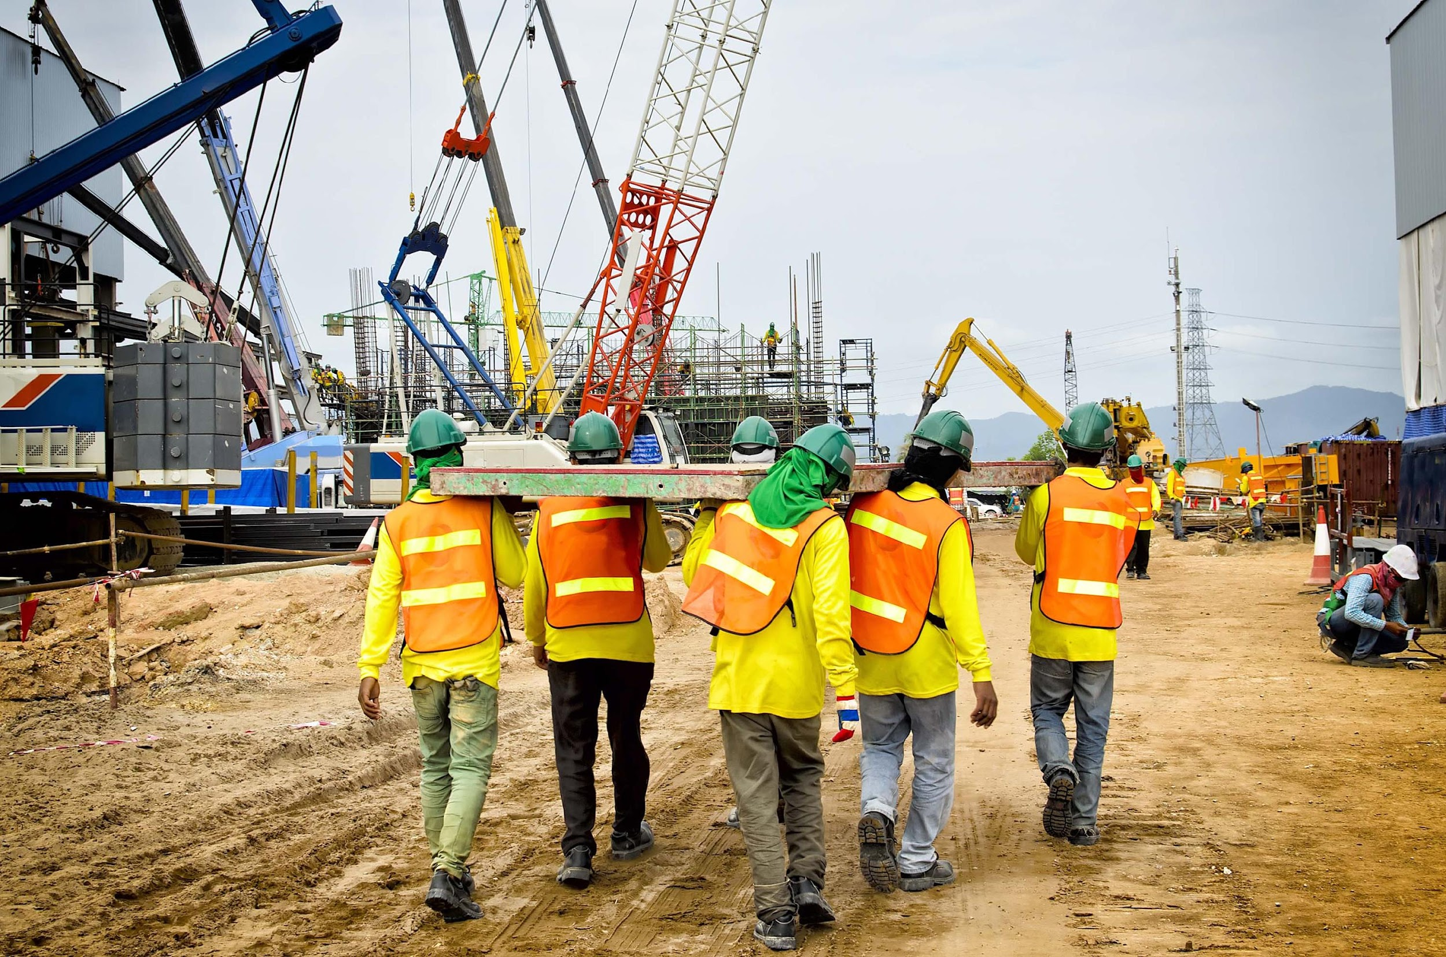
Construction
What is it?
is the process of constructing a building or infrastructure.
Construction differs from manufacturing in that manufacturing typically involves mass production of similar items without a designated purchaser, while construction typically takes place on location for a known client
What types of jobs can you get?
Project Engineer, Construction Superintendent, Construction Estimator, Construction Inspector, Journeyman Electrician, Plumber, Pipefitter, and Carpenter
What is the median salary?
$44,190

Slide 11
Manufacturing
What is it?
is the making of goods by hand or by machine that upon completion the business sells to a customer
What types of jobs can you get?
Food, Beverage, and Tobacco, Textiles, Leather, and Apparel, Wood, Paper, and Printing, Petroleum, Coal, Chemicals, Plastics​, and Rubber, Nonmetallic Mineral, Primary Metal, Fabricated Metal/Machinery, Computer and Electronics, and Electrical Equipment/Appliances/Components.
What is the median salary?
$68,000

Slide 12
Work Ethics
is a set of moral principles a person uses in their job.
People who possess a strong work ethic embody certain principles that guide their work behavior, leading them to produce high-quality work consistently and the output motivates them to stay on track

Slide 13
Examples of Good Work Ethics
Strong Work Ethic
Dependability and Responsibility
Possessing a Positive Attitude
Adaptability
Honesty and Integrity
Cooperation and Teamwork
Organization and High Productivity
Determined to Succeed
Self–Motivated
Strong Self – Confidence

Slide 14
Examples of Bad Work Ethics
Misusing company time
Abusive behavior
Employee theft
Lying to employees
Violating company internet policies
Profanity
Procrastination
Negativity
Tardiness
Poor e-mail communication
Being distracted
Bad body language habits
Poor grammar
Lack of manners
Not interacting with others

